Slide 1
Background Tasks 1
Elvedin Selimoski

Slide 2
The Plan
Threads
AsyncTask
Internet connection

Slide 3
Threads
Elvedin Selimoski

Slide 4
The main thread
Independent path of execution in a running program
Code is executed line by line
App runs on Java thread called "main" or "UI thread"
Draws UI on the screen
Responds to user actions by handling UI events

Slide 5
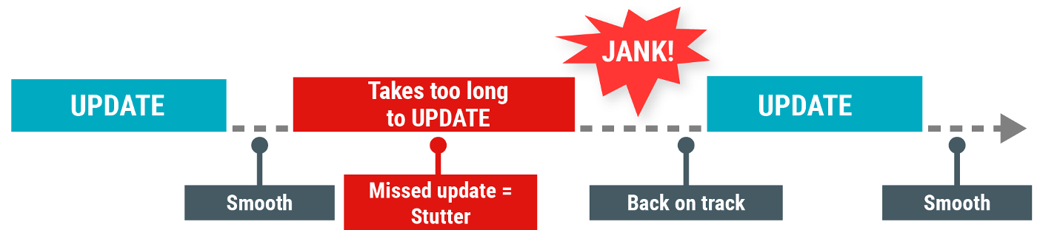
The Main thread must be fast
Hardware updates screen every 16 milliseconds
UI thread has 16 ms to do all its work
If it takes too long, app stutters or hangs
WAIT

Slide 6
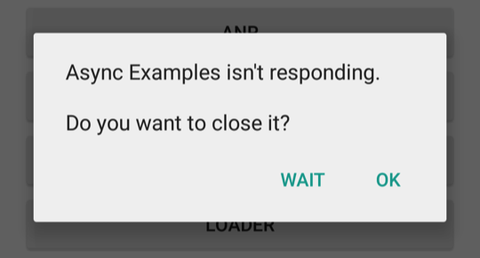
Users uninstall unresponsive apps
If the UI waits too long for an operation to finish, it becomes unresponsive
The framework shows an Application Not Responding (ANR) dialog

Slide 7
What is a long running task?
Network operations
Long calculations
Downloading/uploading files
Processing images
Loading data

Slide 8
Background threads
Execute long running tasks on a background thread
AsyncTask
The Loader Framework
Services
Main Thread (UI Thread)
Update UI
Worker Thread
Do some work

Slide 9
Two rules for Android threads
Do not block the UI thread
  Complete all work in less than 16 ms for each screen
  Run slow non-UI work on a non-UI thread
Do not access the Android UI toolkit from outside the UI thread
  Do UI work only on the UI thread

Slide 10
Ways to access the UI thread from other threads
Activity.runOnUiThread(Runnable)
View.post(Runnable)
View.postDelayed(Runnable, long)

Slide 11
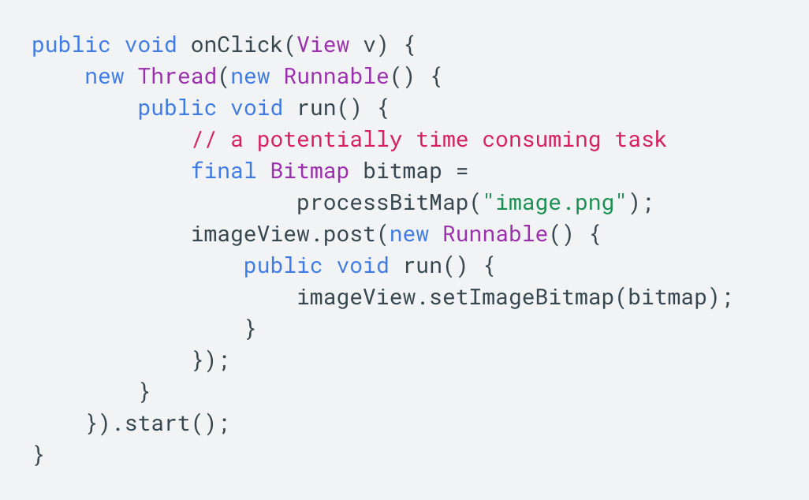
Thread example

Slide 12
AsyncTask
Elvedin Selimoski

Slide 13
What is AsyncTask?
Use AsyncTask to implement basic background tasks
Main Thread (UI Thread)
onPostExecute()
Worker Thread
doInBackground()

Slide 14
Override two methods
doInBackground()—runs on a background thread
  All the work to happen in the background
onPostExecute()—runs on main thread when work done
  Process results
  Publish results to the UI

Slide 15
AsyncTask helper methods
onPreExecute()
  Runs on the main thread
  Sets up the task
onProgressUpdate()
  Runs on the main thread
  receives calls from publishProgress() from background thread

Slide 16
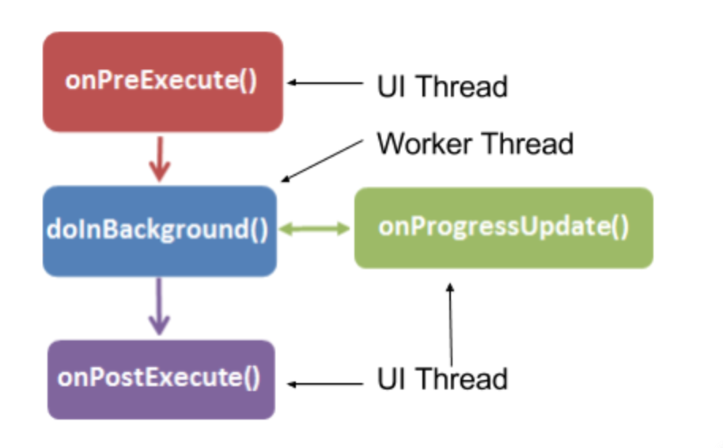
AsyncTask helper methods
Main Thread (UI Thread)
onPreExecute()
onProgressUpdate()
onPostExecute()
Worker Thread
publishProgress()
doInBackground()

Slide 17
Creating an AsyncTask
Subclass AsyncTask
Provide data type sent to doInBackground()
Provide data type of progress units for onProgressUpdate()
Provide data type of result for onPostExecute()
private class MyAsyncTask
extends AsyncTask<URL, Integer, Bitmap> {...}

Slide 18
MyAsyncTask class definition
private class MyAsyncTask
extends AsyncTask<String, Integer, Bitmap> {...}
doInBackground()
doInBackground(
doInBackground()
onProgressUpdate()
onPostExecute()
String—could be query, URI for filename
Integer—percentage completed, steps done
Bitmap—an image to be displayed
Use Void if no data passed

Slide 19
MyAsyncTask methods
protected void onPreExecute() {
// display a progress bar
// show a toast
}
protected Bitmap doInBackground(String... query) {
// Get the bitmap
return bitmap;
}
protected void onProgressUpdate(Integer... progress) {
setProgressPercent(progress[0]);
}
protected void onPostExecute(Bitmap result) {
// Do something with the bitmap
}

Slide 20
Start background work
public void loadImage (View view) {
String query = mEditText.getText().toString();
new MyAsyncTask(query).execute();
}

Slide 21
Limitations of AsyncTask
When device configuration changes, Activity is destroyed
AsyncTask cannot connect to Activity anymore
New AsyncTask created for every config change
Old AsyncTasks stay around
App may run out of memory or crash

Slide 22
When to use AsyncTask
Short or interruptible tasks
Tasks that do not need to report back to UI or user
Lower priority tasks that can be left unfinished
Use AsyncTaskLoader ViewModel otherwise

Slide 23
Internet connection
Elvedin Selimoski

Slide 24
Steps to connect to the Internet
Add permissions to Android Manifest
Check Network Connection
Create Worker Thread
Implement background task
  Create URI
  Make HTTP Connection
  Connect and GET Data
Process results
  Parse Results

Slide 25
Permissions in AndroidManifest
Internet
<uses-permission android:name="android.permission.INTERNET">
Check Network State
<uses-permission
android:name="android.permission.ACCESS_NETWORK_STATE"/>

Slide 26
Getting Network information
ConnectivityManager
  Answers queries about the state of network connectivity
  Notifies applications when network connectivity changes
NetworkInfo
  Describes status of a network interface of a given type
  Mobile or Wi-Fi

Slide 27
Check if network is available
ConnectivityManager connMgr = (ConnectivityManager)
getSystemService(Context.CONNECTIVITY_SERVICE);
NetworkInfo networkInfo = connMgr.getActiveNetworkInfo();
if (networkInfo != null && networkInfo.isConnected()) {
// Create background thread to connect and get data
new DownloadWebpageTask().execute(stringUrl);
} else {
textView.setText("No network connection available.");
}

Slide 28
Check for WiFi & Mobile
NetworkInfo networkInfo =
connMgr.getNetworkInfo(ConnectivityManager.TYPE_WIFI);
boolean isWifiConn = networkInfo.isConnected();
networkInfo =
connMgr.getNetworkInfo(ConnectivityManager.TYPE_MOBILE);
boolean isMobileConn = networkInfo.isConnected();

Slide 29
Use Worker Thread
AsyncTask—very short task, or no result returned to UI
AsyncTaskLoader—for longer tasks, returns result to UI
Background Service—later chapter

Slide 30
Background work
In the background task (for example in doInBackground())
  Create URI
  Make HTTP Connection
  Download Data

Slide 31
URI = Uniform Resource Identifier
String that names or locates a particular resource
  file://
  http:// and https://
  content://

Slide 32
Sample URL for Google Books API
https://www.googleapis.com/books/v1/volumes? q=pride+prejudice&maxResults=5&printType=books
Constants for Parameters
final String BASE_URL =
"https://www.googleapis.com/books/v1/volumes?";
final String QUERY_PARAM = "q";
final String MAX_RESULTS = "maxResults";
final String PRINT_TYPE = "printType";

Slide 33
Build a URI for the request
Uri builtURI = Uri.parse(BASE_URL).buildUpon()
.appendQueryParameter(QUERY_PARAM, "pride+prejudice")
.appendQueryParameter(MAX_RESULTS, "10")
.appendQueryParameter(PRINT_TYPE, "books")
.build();
URL requestURL = new URL(builtURI.toString());

Slide 34
Make a connection from scratch
Use HttpURLConnection
Must be done on a separate thread
Requires InputStreams and try/catch blocks

Slide 35
Make a connection from scratch
HttpURLConnection conn =
(HttpURLConnection) requestURL.openConnection();

Slide 36
Configure connection
conn.setReadTimeout(10000 /* milliseconds */);
conn.setConnectTimeout(15000 /* milliseconds */);
conn.setRequestMethod("GET");
conn.setDoInput(true);

Slide 37
Connect and get response
conn.connect();
int response = conn.getResponseCode();
InputStream is = conn.getInputStream();
String contentAsString = convertIsToString(is, len);
return contentAsString;

Slide 38
Close connection and stream
} finally {
conn.disconnect();
if (is != null) {
is.close();
}
}

Slide 39
Convert input stream into a string
public String convertIsToString(InputStream stream, int len)
throws IOException, UnsupportedEncodingException {
Reader reader = null;
reader = new InputStreamReader(stream, "UTF-8");
char[] buffer = new char[len];
reader.read(buffer);
return new String(buffer);
}

Slide 40
BufferedReader is more efficient
StringBuilder builder = new StringBuilder();
BufferedReader reader =
new BufferedReader(new InputStreamReader(inputStream));
String line;
while ((line = reader.readLine()) != null) {
builder.append(line + "\n");
}
if (builder.length() == 0) {
return null;
}
resultString = builder.toString();

Slide 41
Make a connection using libraries
Use a third party library like OkHttp or Volley
Can be called on the main thread
Much less code

Slide 42
Volley
RequestQueue queue = Volley.newRequestQueue(this);
String url ="http://www.google.com";
StringRequest stringRequest = new StringRequest(Request.Method.GET, url,
new Response.Listener<String>() {
@Override
public void onResponse(String response) {
// Do something with response
}
}, new Response.ErrorListener() {
@Override
public void onErrorResponse(VolleyError error) {}
});
queue.add(stringRequest);

Slide 43
OkHttp
OkHttpClient client = new OkHttpClient();
Request request = new Request.Builder()
.url("http://publicobject.com/helloworld.txt").build();
client.newCall(request).enqueue(new Callback() {
@Override
public void onResponse(Call call, final Response response)
throws IOException {
try {
String responseData = response.body().string();
JSONObject json = new JSONObject(responseData);
final String owner = json.getString("name");
} catch (JSONException e) {}
}
});

Slide 44
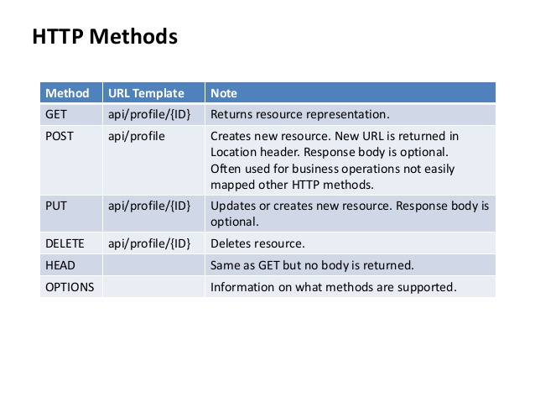
REST Methods

Slide 45
Parsing the results
Implement method to receive and handle results
( onPostExecute())
Response is often JSON or XML
Parse results using helper classes
JSONObject, JSONArray
XMLPullParser—parses XML

Slide 46
JSON basics
{
"population":1,252,000,000,
"country":"India",
"cities":["New Delhi","Mumbai","Kolkata", "Chennai"]
}

Slide 47
JSONObject basics
JSONObject jsonObject = new JSONObject(response);
String nameOfCountry = (String) jsonObject.get("country");
long population = (Long) jsonObject.get("population");
JSONArray listOfCities = (JSONArray) jsonObject.get("cities");
Iterator<String> iterator = listOfCities.iterator();
while (iterator.hasNext()) {
// do something
}

Slide 48
Another JSON example
{"menu": {
"id": "file",
"value": "File",
"popup": {
"menuitem": [
{"value": "New", "onclick": "CreateNewDoc()"},
{"value": "Open", "onclick": "OpenDoc()"},
{"value": "Close", "onclick": "CloseDoc()"}
]
}
}

Slide 49
Another JSON example
Get "onclick" value of the 3rd item in the "menuitem" array
JSONObject data = new JSONObject(responseString);
JSONArray menuItemArray =
data.getJSONArray("menuitem");
JSONObject thirdItem =
menuItemArray.getJSONObject(2);
String onClick = thirdItem.getString("onclick");

Slide 50
Parsing the results
Connect to the Network Guide
Managing Network Usage Guide
HttpURLConnection reference
ConnectivityManager reference
InputStream reference

Slide 51
END

